Slide 1

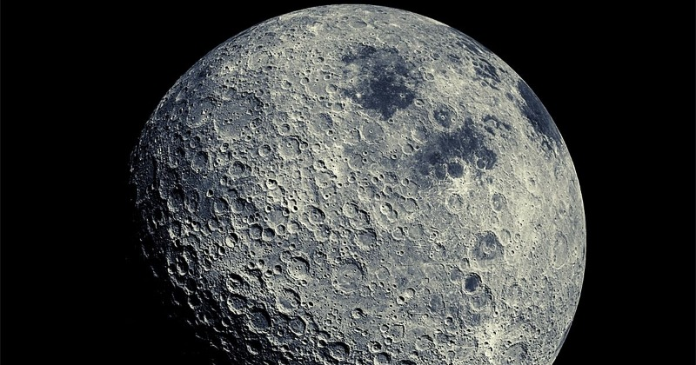
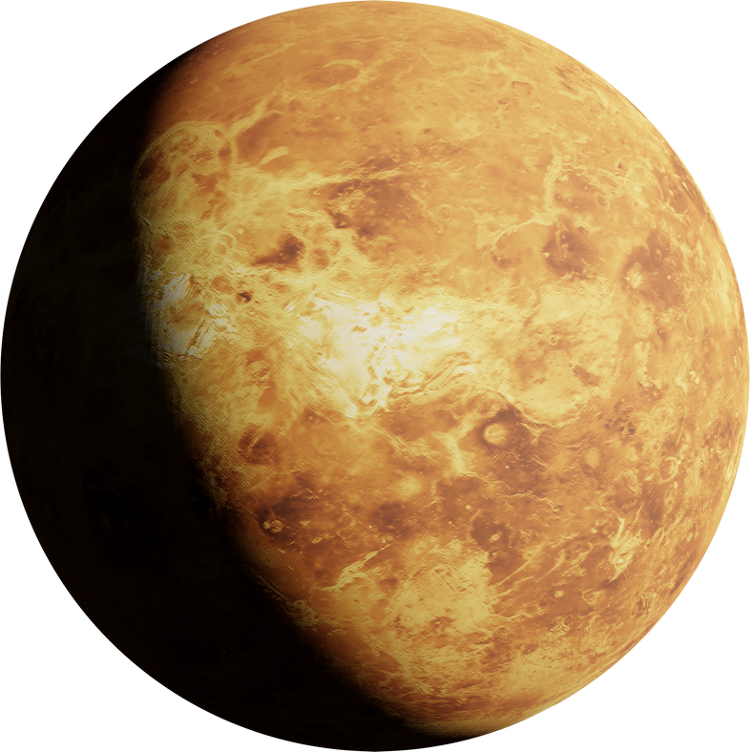
ECLIPSE EXPLORER
ECLIPSE: PERSPECTIVE IS EVERYTHING
Mihir patel
zeel patel
jay patel

Slide 2
Aim
-Making Userfriendly website to easily understand the eclipse.
-Use images, videos, and diagrams to illustrate your points.
-Describe the causes of eclipses, including the alignment of the Sun, Moon, and Earth.

Slide 3
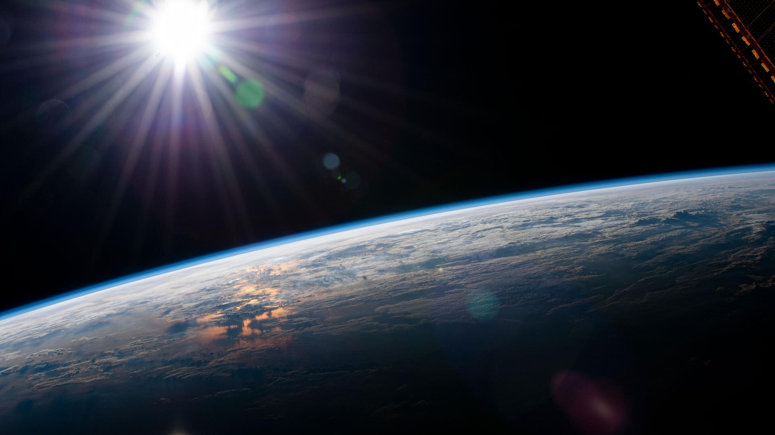
Introduction of project
we are going to make
attractive frontend website.
which is use to understand about eclipse easily.
The website having attractive Images and videos
as well as game .

Slide 4
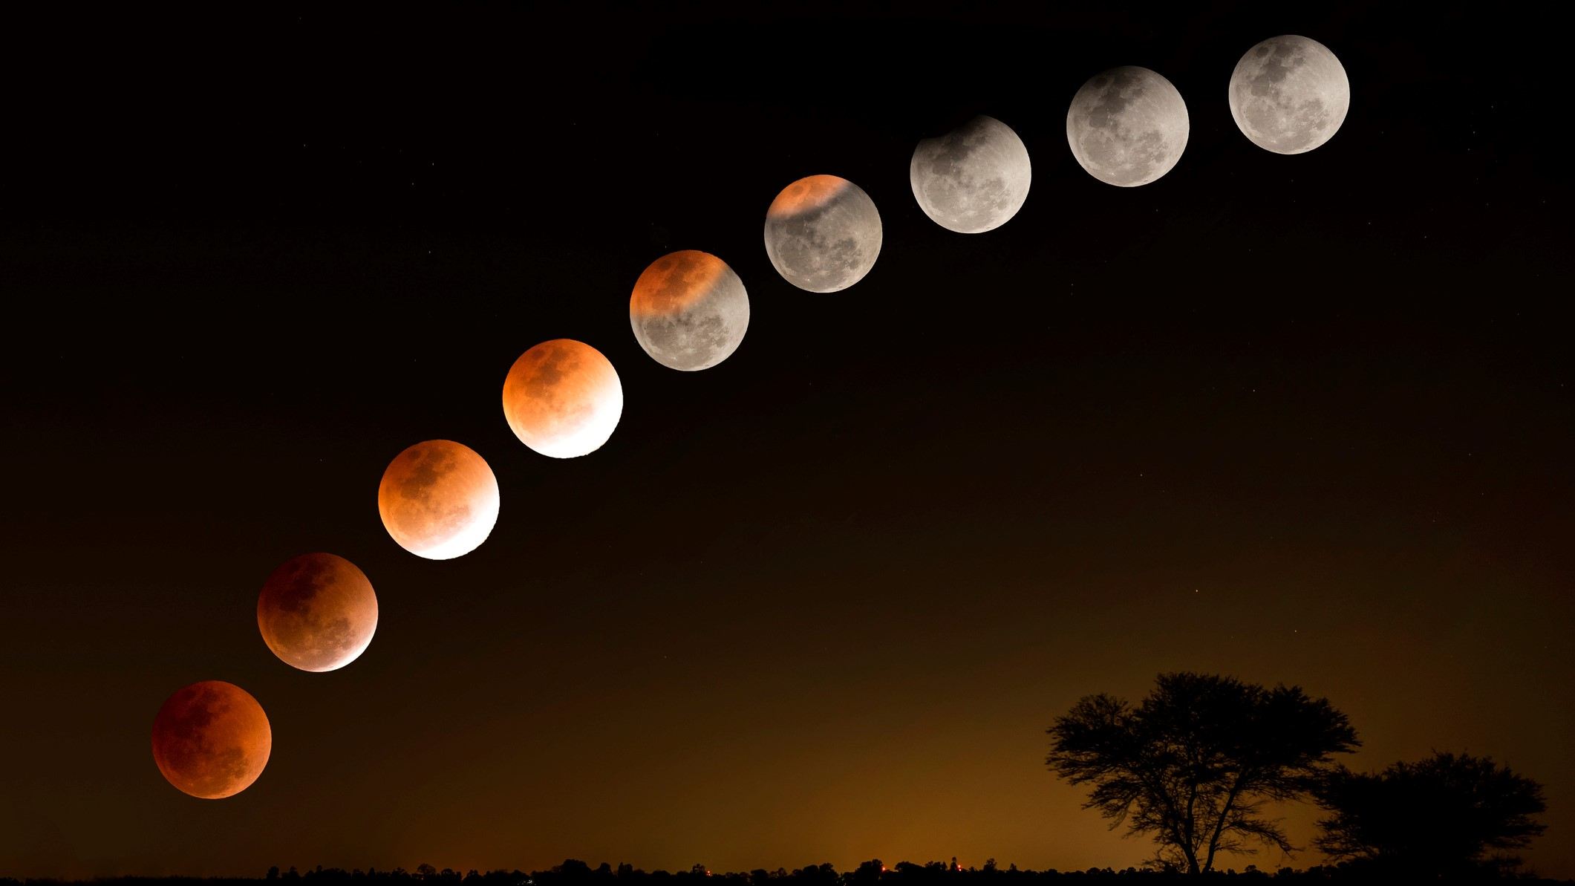
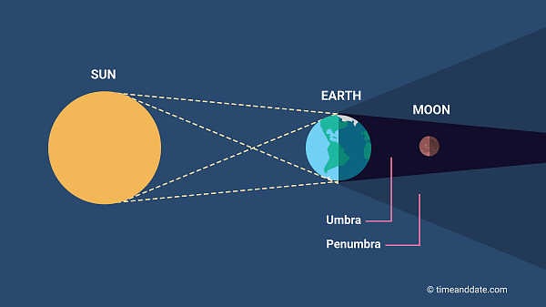
Lunar eclipse
Lunar eclipses occur when the Earth passes between the Sun and the Moon, blocking the sunlight that is normally reflected by the Moon. This can only happen during a full moon, when the Sun and Moon are opposite each other in the sky.

Slide 5
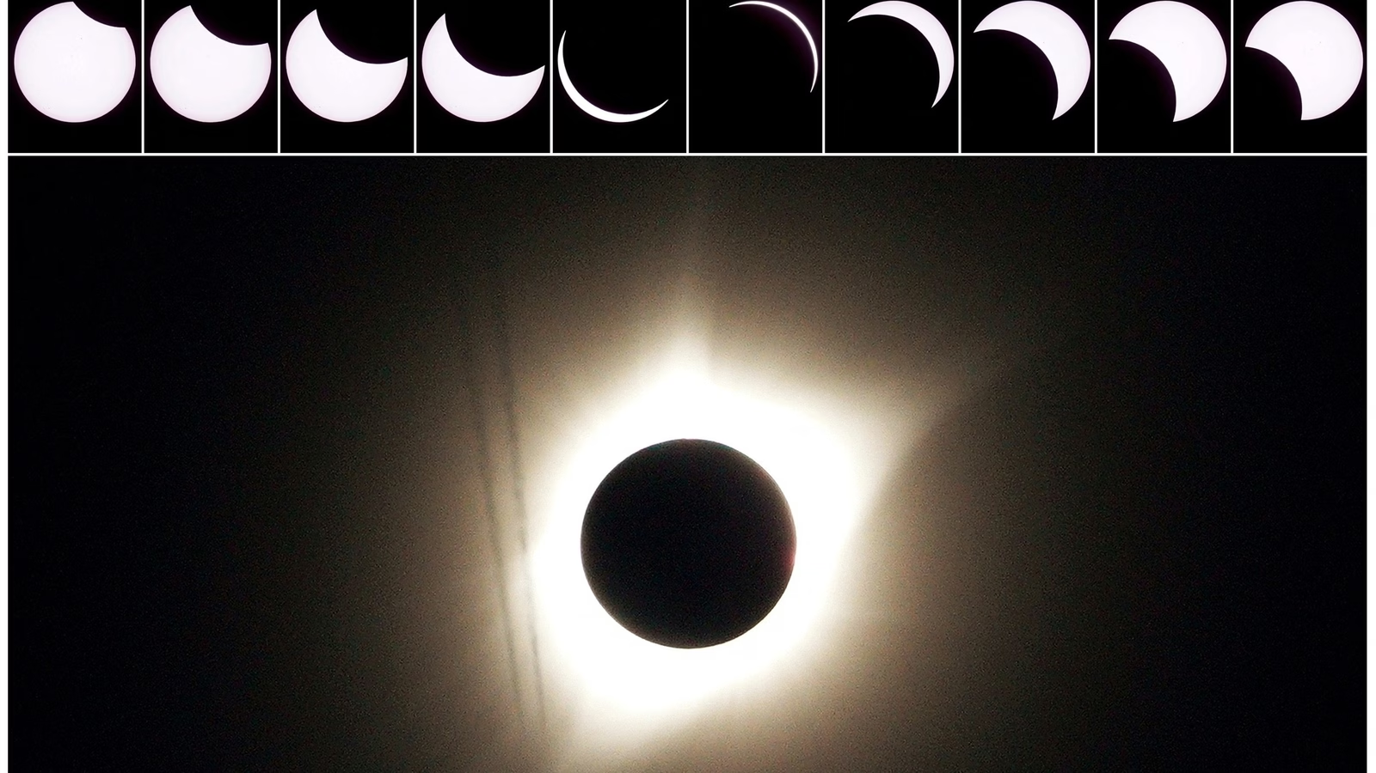
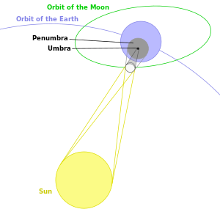
Solar Eclipse
Solar eclipses occur when the Moon passes between the Earth and the Sun, casting a shadow on the Earth. This can only happen during a new moon, when the Sun and Moon are aligned

Slide 6
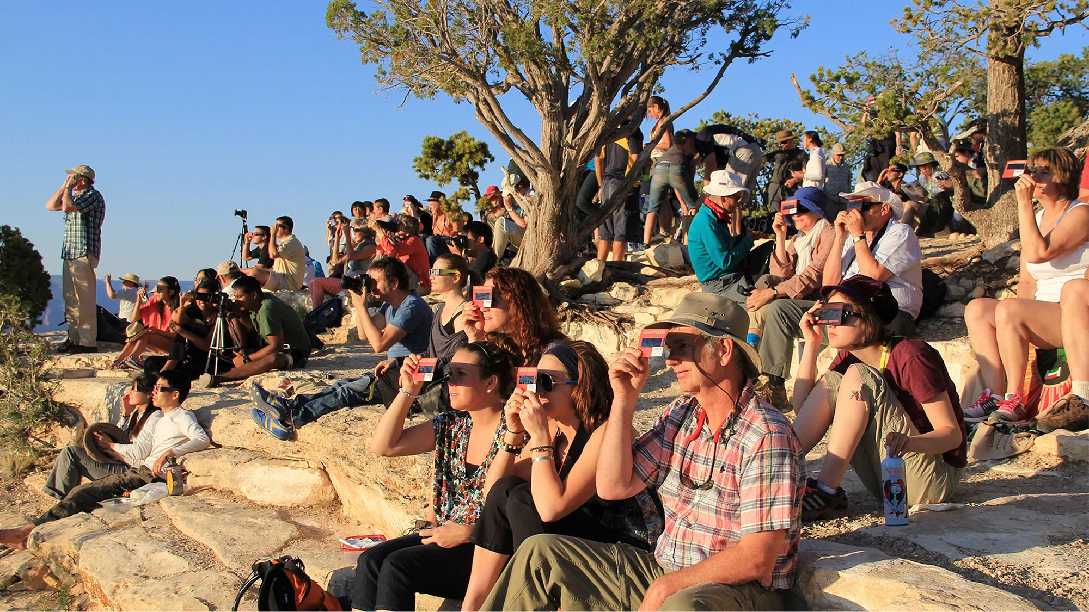
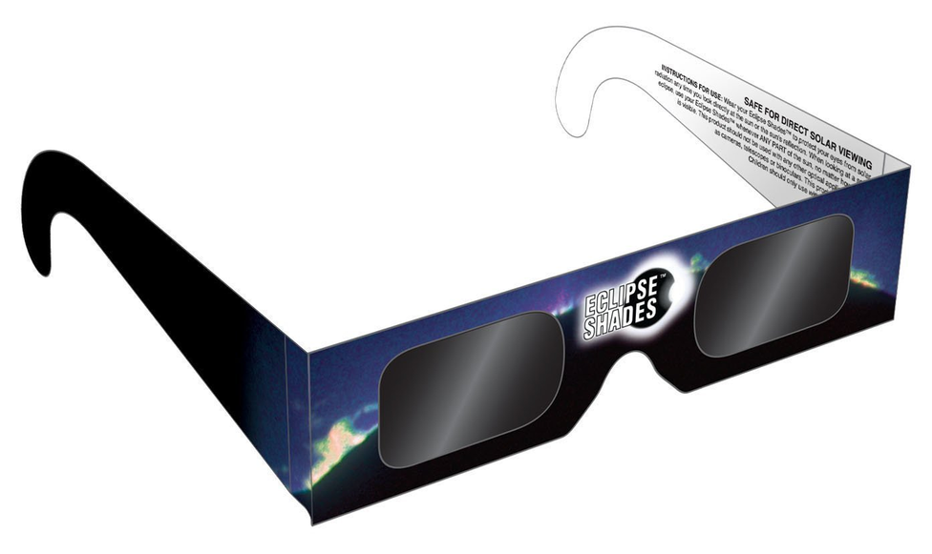
Eye Safety for Partial and Annular Solar Eclipses
When watching a partial or annular solar eclipse directly with your eyes, you must look through safe solar viewing glasses (“eclipse glasses”) or a safe handheld solar viewer at all times. Eclipse glasses are NOT regular sunglasses; regular sunglasses, no matter how dark, are not safe for viewing the Sun.

Slide 7
Thank you

